Slide 1
Physics of Digital Data Storage
Tenzin Rigden

Slide 2
Overview
Introduction
Magnetic Data Storage
Hard Disk Drives
Optical Data Storage
CD, DVD, Blu-Ray
Flash Storage
Solid State Drives
Holographic Data Storage
Conclusion

Slide 3
How is Data stored
Data is stored as 1’s and 0’s called bits
Can represent numbers as a sequence of bits
0111 = 33
Can use binary to represent text using ASCII

Slide 4
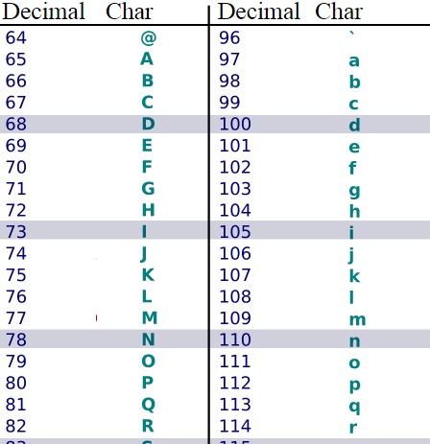
ASCII Table
1010010 = 82 in binary

Slide 5
Magnetic Data Storage
Hard Disk Drives (HDD)
First HDD released was 350 RAMAC in 1956 and stored 3.75 MB
Most popular method of storage for computers

Slide 6
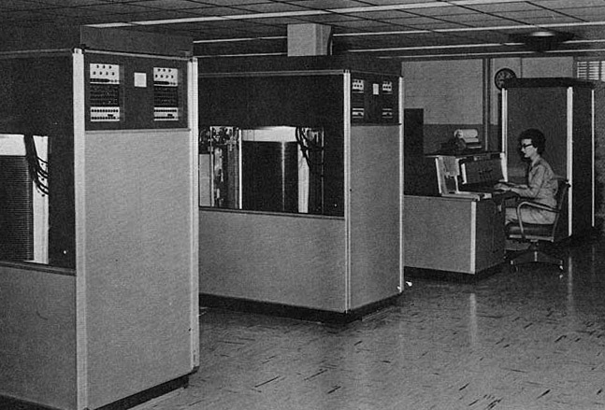

Slide 7
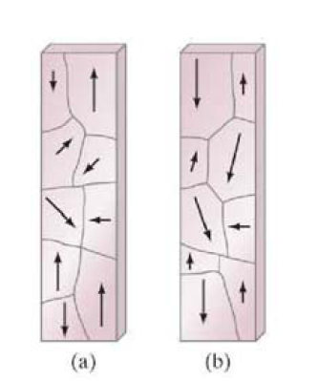
Background
Magnetic storage takes advantage of ferromagnetism.
Ferromagnetic materials composed of small magnetic domains
Due to quantum mechanical spin of electrons.
J. R. Taylor, M. A. Dubson and C. D. Zaratos, Modern physics for scientists and engineers (Prentice-Hall, 2004)
Notes:
Pauli-Exclusion Principle and the coloumb repulsion force.

Slide 8
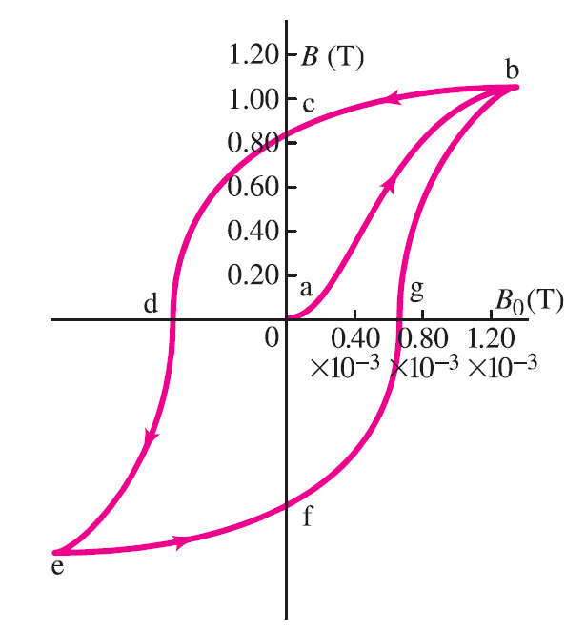
Hysteresis loop
Hysteresis loop corresponds to ferromagnets property where they will sustain their domain alignments
Allows us to store data
J. R. Taylor, M. A. Dubson and C. D. Zaratos, Modern physics for scientists and engineers (Prentice-Hall, 2004)

Slide 9
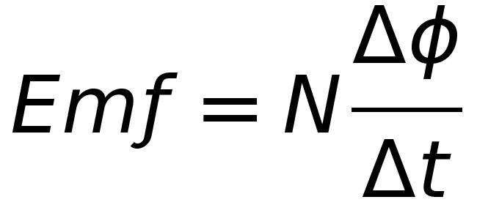

Maxwell’s Equations
Faraday’s Law of Induction
Ampere’s Law

Slide 10
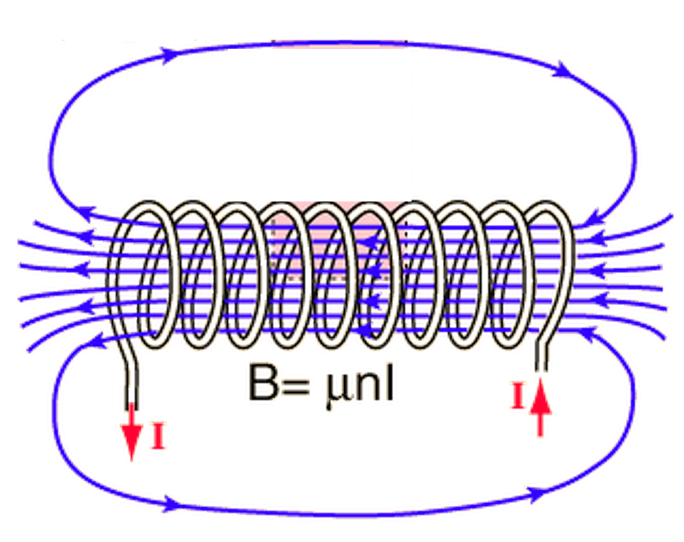
http://hyperphysics.phy-astr.gsu.edu/hbase/magnetic/imgmag/sol.gif

Slide 11
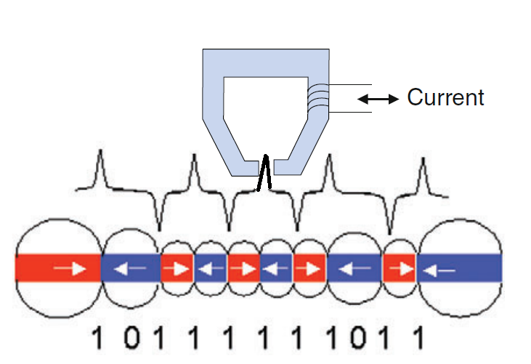
Basic HDD
To write, apply potential across wire to induce B field
To read, attach capacitor to the wire and when
S. N. Piramanayagam, Perpendicular recording media for hard disk drives, Journal of Applied Physics
102 (2007) (1), p. 11301
Notes:
Ferrite head

Slide 12
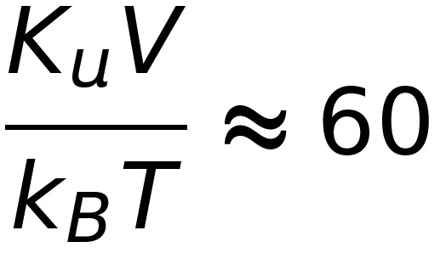
limitations
Super Paramagnetism Limit
K_{u} = anisotropy constant of the material
V = volume of the domain
k_{b} is boltzman’s constant and T is the temperature.

Slide 13
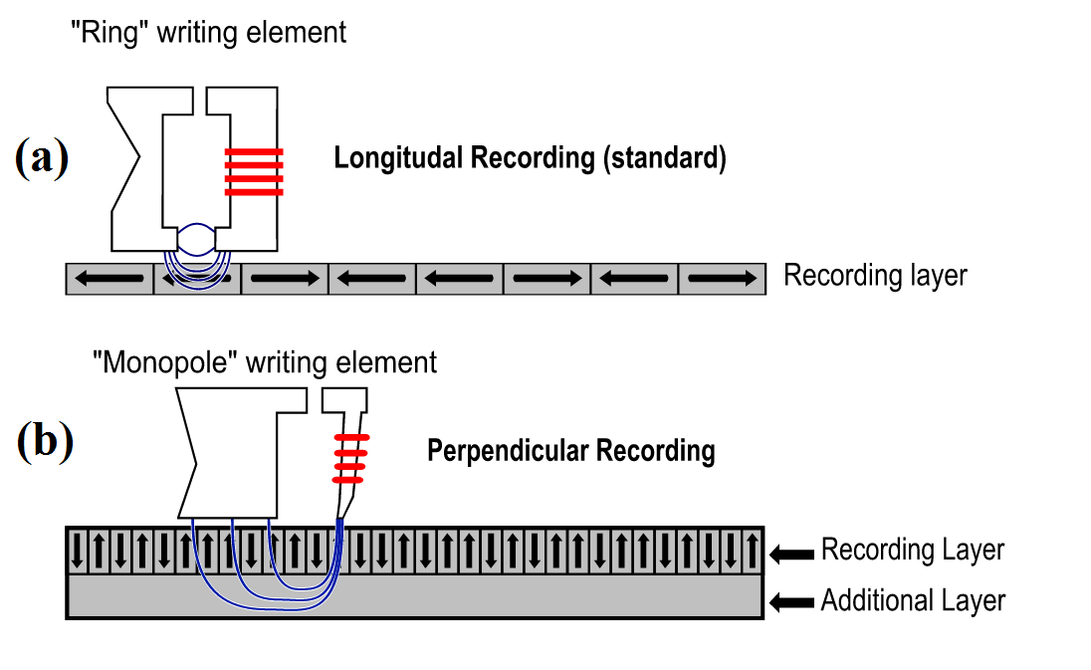
Perpendicular recording
S. N. Piramanayagam, Perpendicular recording media for hard disk drives, Journal of Applied Physics
102 (2007) (1), p. 11301

Slide 14
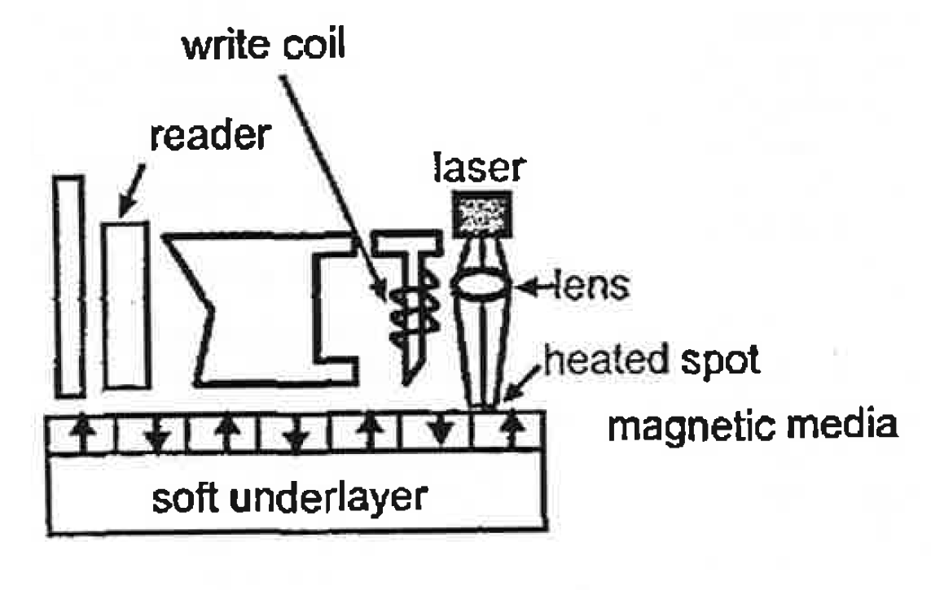
Heat Assisted Magnetic Recording (HAMR)
L. Pan and D. B. Bogy, Data storage: Heat-assisted magnetic recording, Nature Photonics 3 (2009) (4),
pp. 189{190

Slide 15
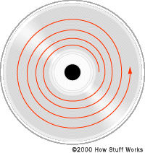
Compact Disc
First released in 1982
Was originally designed to store and play music
Have a spiral track as opposed to HDD

Slide 16
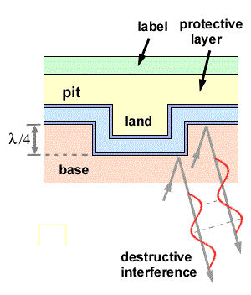
CD-Rom
Bits represented by pits and lands.
Phase difference between land and pit causes destructive interference
G. Campardo, F. Tiziani and M. Iaculo, Memory Mass Storage (Springer Berlin Heidelberg, 2011),
URL: https://books.google.com/books?id=5hxzxjTsTEQC

Slide 17

Increasing Density
Want to minimize beam spot size
There is a limit due to diffraction
Diffraction is when light self interferes
http://cdn.cambridgeincolour.com/images/tutorials/airydisk-rings.jpg

Slide 18
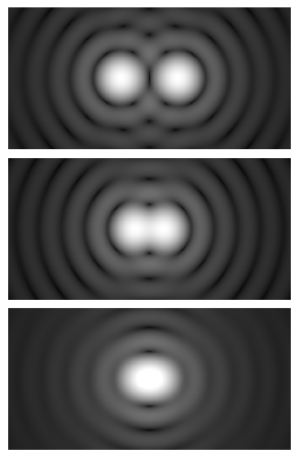
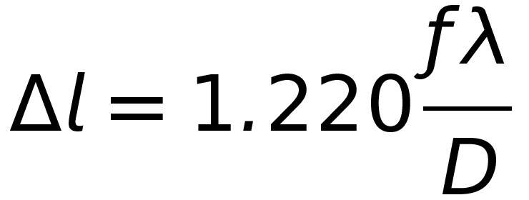
Rayleigh’s Criterion
Defines the minimum resolvable distance between two objects
http://upload.wikimedia.org/wikipedia/commons/a/ae/Airy_disk_spacing_near_Rayleigh_criterion.png

Slide 19
DVD and Blu-Ray
DVD first released in in 1996
Uses 650 nm light
Numerical Aperture of around .65
Blu-Ray first released 2006
Uses 405 nm light
Numerical Aperture of around .85
Notes:
1995

Slide 20
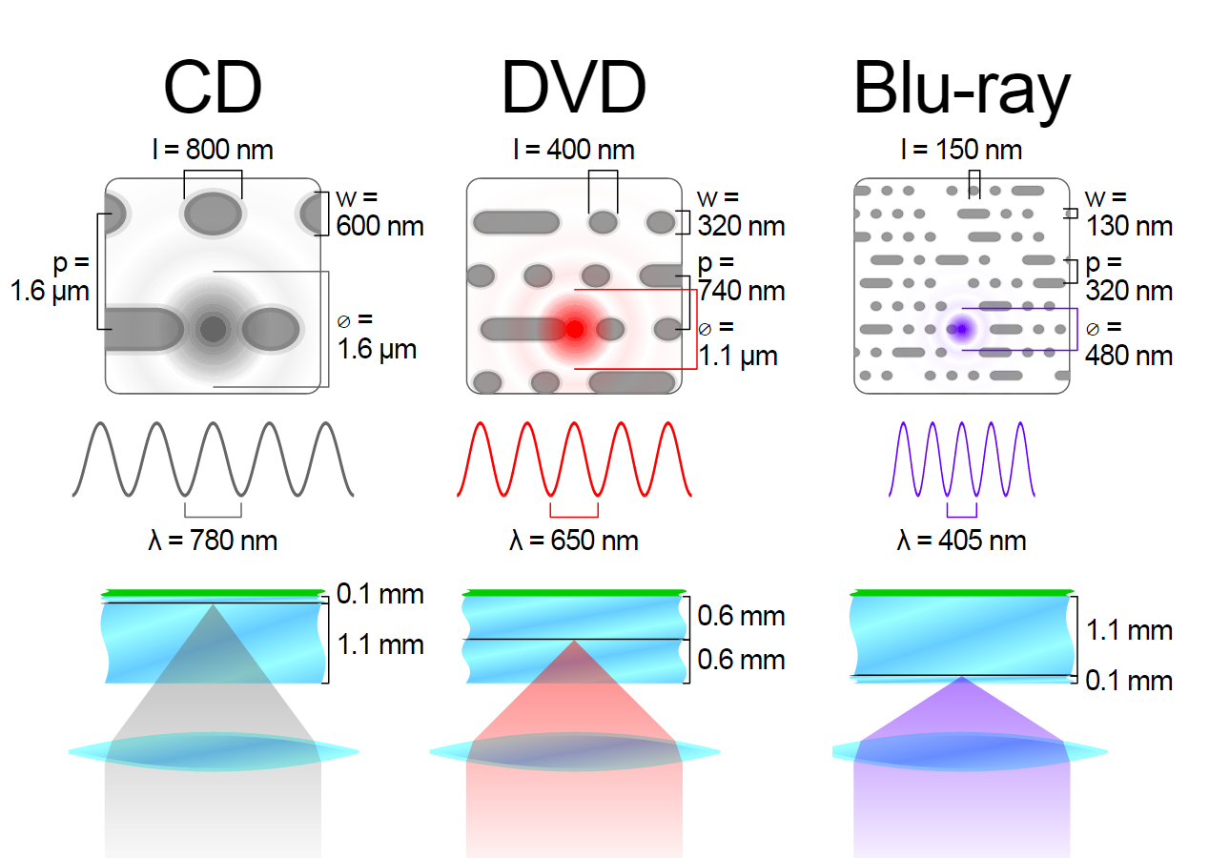
Summary
http://upload.wikimedia.org/wikipedia/commons/thumb/a/ad/Comparison_CD_DVD_HDDVD_BD.svg/300px-Comparison_CD_DVD_HDDVD_BD.svg.png

Slide 21
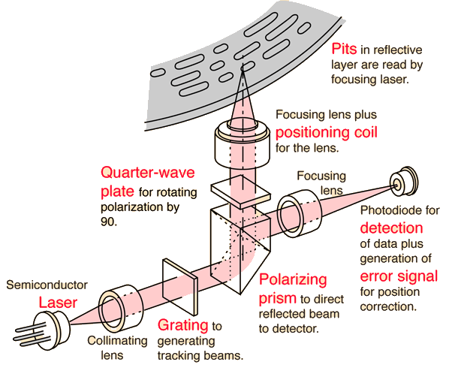
Laser Diagram
http://hyperphysics.phy-astr.gsu.edu/hbase/audio/imgaud/cdplay.gif

Slide 22
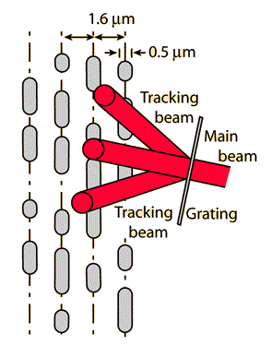
Laser Tracking
Use a diffraction grating to produce tracking beams
First order diffraction maximum on each side of main beam.
Difference in brightness of two tracking beams used to center main beam.
http://hyperphysics.phy-astr.gsu.edu/hbase/audio/imgaud/ltrac.gif

Slide 23
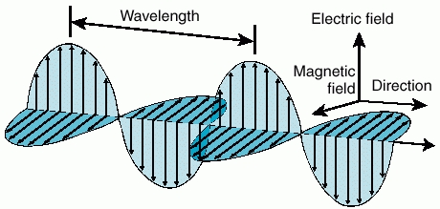
Polarization
Polarization is the orientation of the electric field.
Unpolarized light means it has random orientations

Slide 24
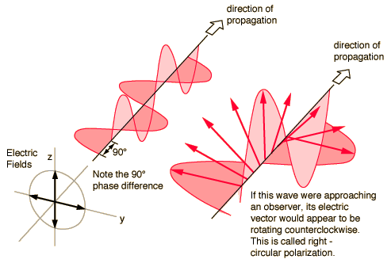
Quarter Wave plate
Quarter wave plate has a fast and slow axis.
Applies a 90 degree phase between the axis
Converts linearly polarized light to circularly polarized

Slide 25
Quarter Wave plate

Slide 26
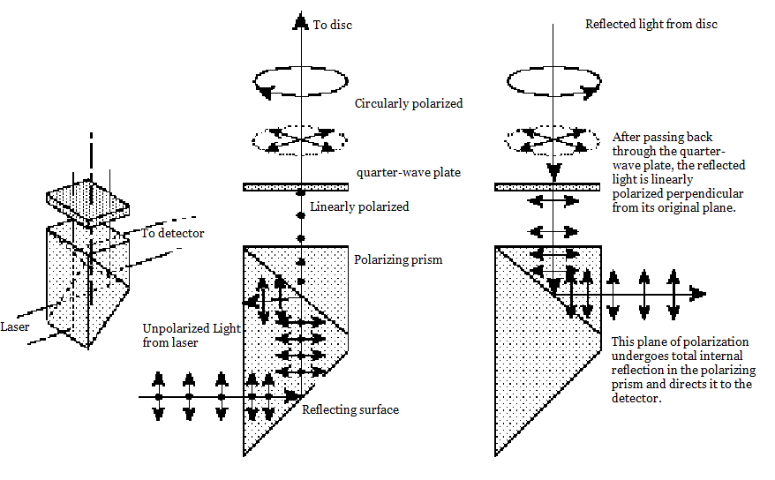
Polarizing Prism
http://hyperphysics.phy-astr.gsu.edu/hbase/phyopt/imgpho/cdpri.gif

Slide 27
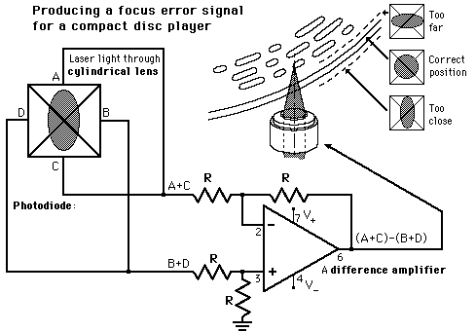

Lens System
Use both a cylindrical lens and a symmetric lens system
Only one distance past cylindrical lens that will produce a circular beam.
Produced error voltage drives coil that repositions lens.
http://www.electronics.dit.ie/staff/tscarff/DISKS/CD/focus.gif

Slide 28
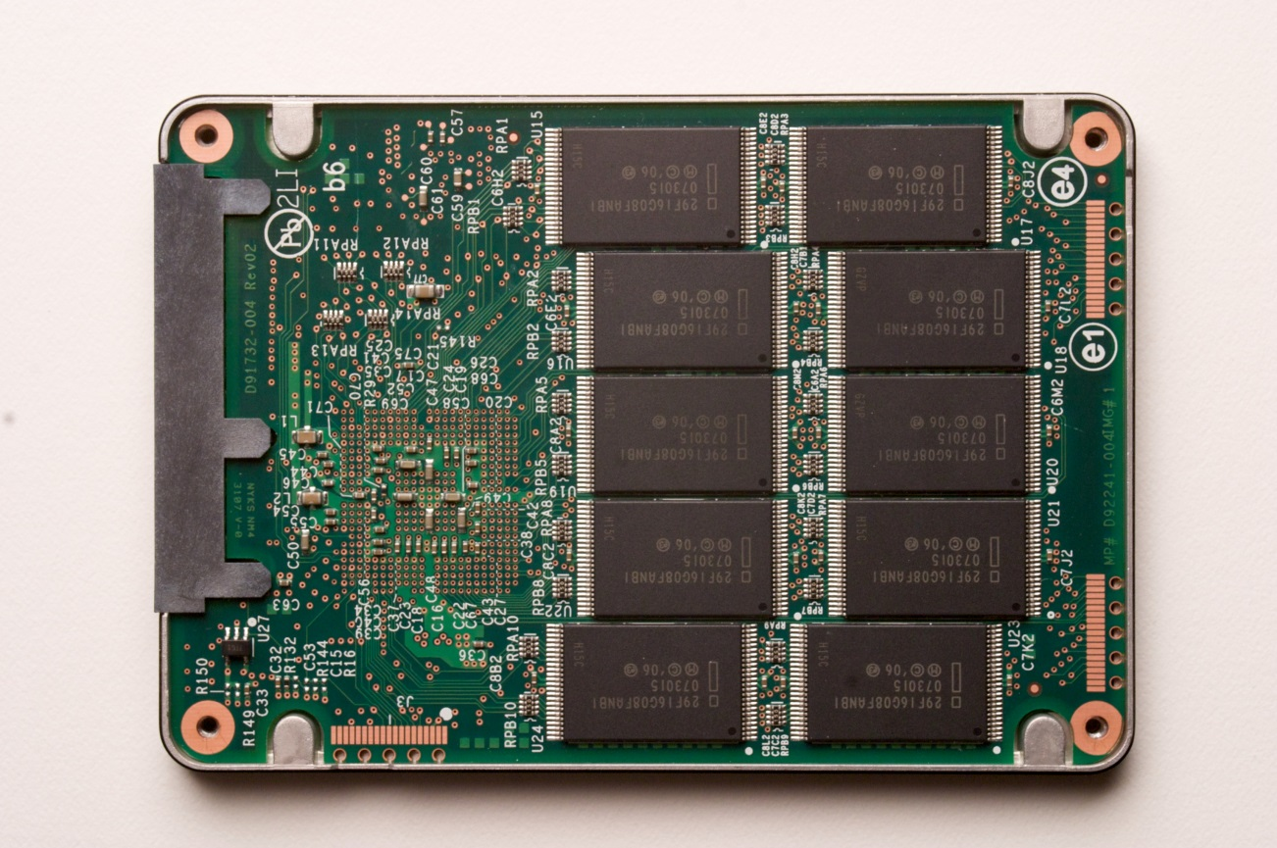
Flash Storage
Examples: Solid State Drives, usb sticks, memory cards
Read speeds of up to 500 MB/s

Slide 29
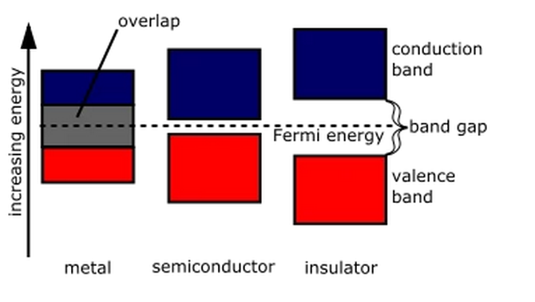
SemiConductors

Slide 30
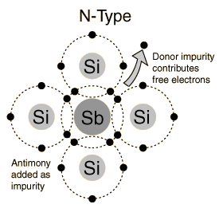
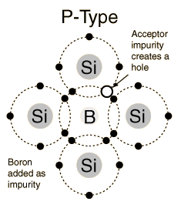
P and n type Doping

Slide 31
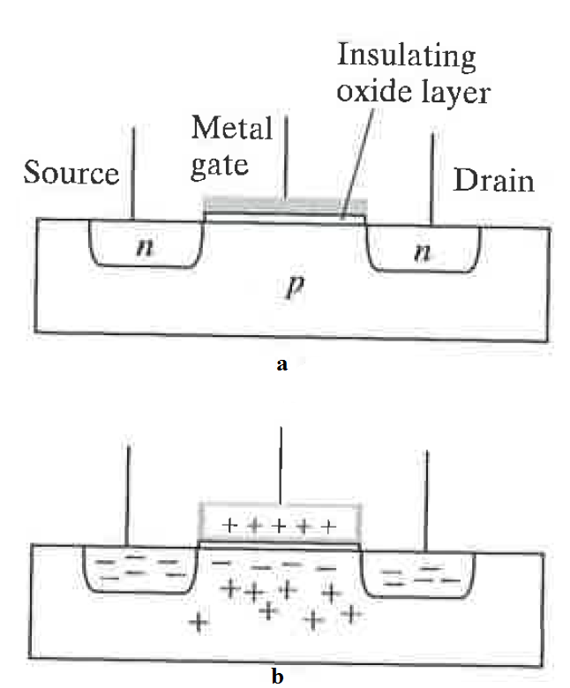
Mosfet

Slide 32
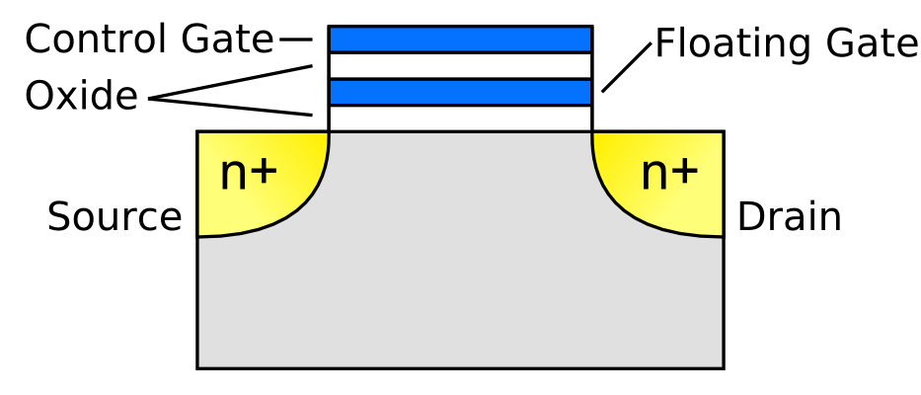
Floating Gate Transistor
http://elec424.rice.edu/gigamesh/images/Floating_Gate_Transistor.png

Slide 33
Holographic Data storage
Holograms are three-dimensional images that are created by interference of light.
First practical holograms were recorded in 1962.
Due to reversibility of light

Slide 34
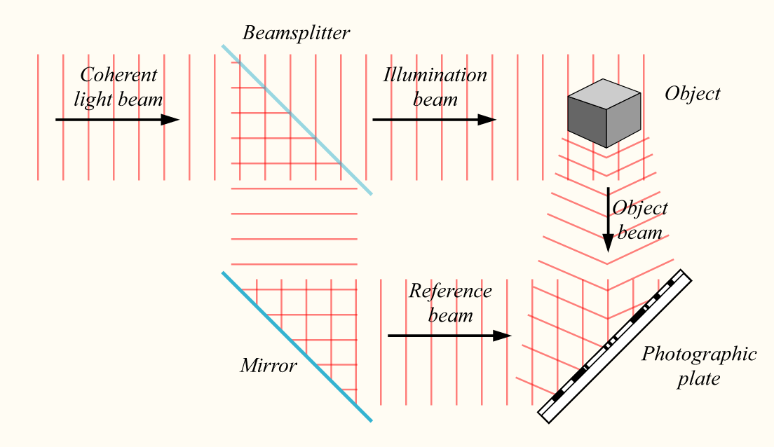
Creating a hologram
K. Curtis, L. Dhar, A. Hill, W. Wilson and M. Ayres, Holographic data storage (Wiley Online Library, 2010)

Slide 35
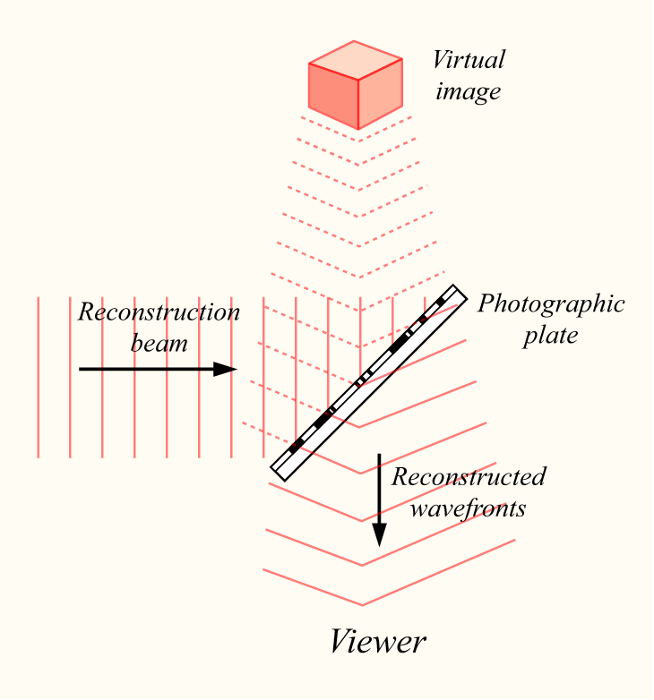
Viewing a hologram
K. Curtis, L. Dhar, A. Hill, W. Wilson and M. Ayres, Holographic data storage (Wiley Online Library, 2010)

Slide 36
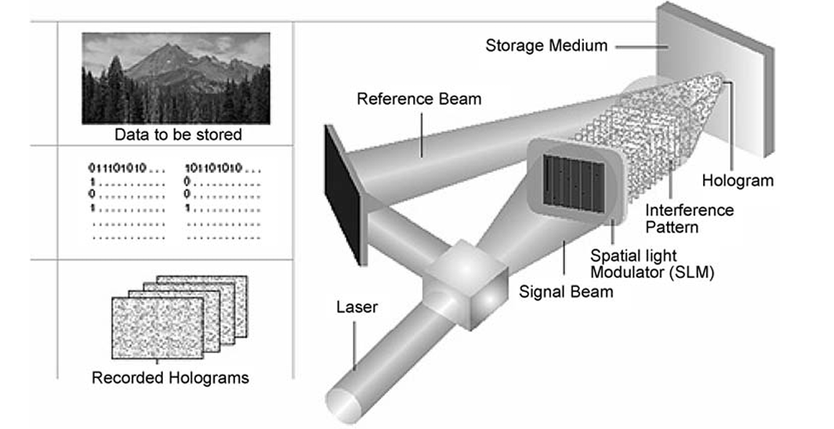
Applied
K. Curtis, L. Dhar, A. Hill, W. Wilson and M. Ayres, Holographic data storage (Wiley Online Library, 2010)

Slide 37
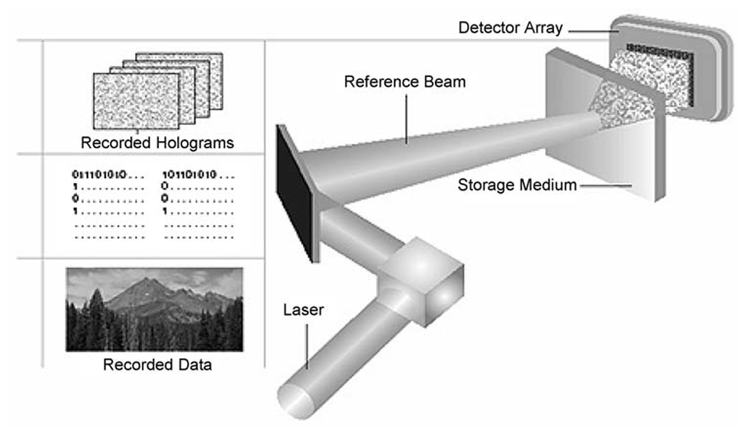
K. Curtis, L. Dhar, A. Hill, W. Wilson and M. Ayres, Holographic data storage (Wiley Online Library, 2010)

Slide 38
Multiplexing
Can further increase density by
Can change angle of incidence for the reference beam
Can change wavelength of light used

Slide 39
Thanks!
Advisor: Marty Baylor
Peer Advisor: Leah Crane
Those who came to practice talk
Friends and Family
The physics department
And all of you!

Slide 40
references
[1] G. Campardo, F. Tiziani and M. Iaculo, Memory Mass Storage (Springer Berlin Heidelberg, 2011),
URL: https://books.google.com/books?id=5hxzxjTsTEQC
[2] K. Curtis, L. Dhar, A. Hill, W. Wilson and M. Ayres, Holographic data storage (Wiley Online Library,
2010)
[3] E. M. Purcell and D. J. Morin, Electricity and Magnetism, 3rd ed. (Cambridge Univeristy Press, 2013)
[4] Y. Song, High density data storage: Principle, Technology, and Materials (World Scientic, 2009)
[5] S. N. Piramanayagam, Perpendicular recording media for hard disk drives, Journal of Applied Physics
102 (2007) (1), p. 11301
20
[6] L. Pan and D. B. Bogy, Data storage: Heat-assisted magnetic recording, Nature Photonics 3 (2009) (4),
pp. 189{190
[7] J. R. Taylor, M. A. Dubson and C. D. Zaratos, Modern physics for scientists and engineers (Prentice-Hall, 2004)

